Slide 1

Green Pace
Security Policy Presentation
Developer: Talia Cunningham

Slide 2

OVERVIEW: DEFENSE IN DEPTH
Defense against depth(DiD)
Physical Security
Cloud Security
Perimeter Security
Network Security

Slide 3
THREATS MATRIX
Likely IDS-000-J | Priority IDS-000-J = P18
Low priority DCL-003-C = P1 | Unlikely DCL-003-C

Slide 4
10 PRINCIPLES
Validate Input Data
Heed Compiler Warnings
Architect and Design for Security Policies
Keep It simple
Default Deny
Adhere to the Principle of Least Privilege
Sanitize Data Sent to Other Systems
Practice Defense in Depth
Use Effective Quality Assurance Techniques
Adopt a Secure Coding Standard

Slide 5
CODING STANDARDS
Implement abstract data types using opaque types
Ensure that integer conversions do not result in lost or misinterpreted data
Do not pass a non-null-terminated character sequence to a library function that expects a string
Prevent SQL injection
Do not access freed memory
Use a static assertion to test the value of a constant expression
Honor exception specifications
Use parentheses for precedence of operation
Do not use std::rand() for generating pseudorandom numbers
Range check element access

Slide 6
ENCRYPTION POLICIES
Encryption in rest - Ensure that data is protected when on a disk.
Encryption at flight - Ensure that data is protected while being transmitted.
Encryption in use - Ensure that sensitive data is protected at all stages.

Slide 7
TRIPLE-A POLICIES
Authentication - is the process of verifying that the correct individual is gaining access to the system.
Authorization - pertains to the rights and privileges granted to a user who has been authenticated.
Accounting - involves keeping track of various activities and documenting them for purposes of ensuring compliance and security.

Slide 8
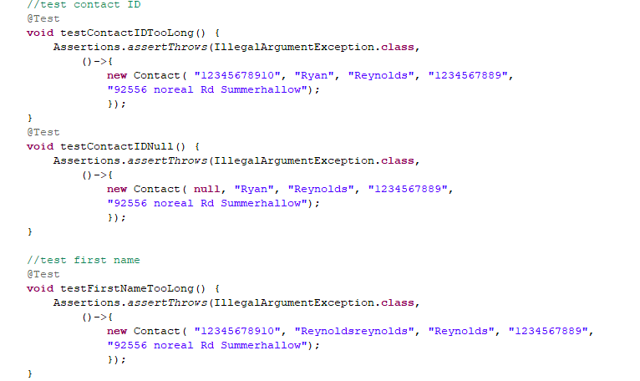
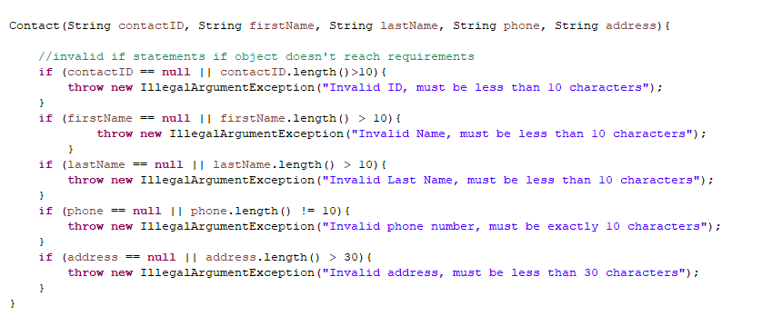
Unit Testing
Figure 1
Figure 2

Slide 9

AUTOMATION SUMMARY

Slide 10
TOOLS
DevSecOps pipeline is an efficient method of providing software that is secure and of high quality.
Tools:
SAST
DAST
IAST
SCA

Slide 11
RISKS AND BENEFITS
Acting now
Prevents threats
Saves Money
Waiting
Financial costs
Harm to data
ruins trust with clients

Slide 12
RECOMMENDATIONS
Enable Multi-Factor Authentication
Keep Software Updated
Regularly Back Up Data

Slide 13
CONCLUSIONS
At Green Pace, transforming DevOps into DevSecOps requires adopting coding standards, implementing defense in depth, considering potential attack motives, and maintaining a "no one is safe" attitude towards security throughout development.

Slide 14
REFERENCES
Hubbard, B. (2023, August 3). Defining your it network security perimeter. IT Management Software. https://blog.invgate.com/defining-your-it-security-perimeter#:~:text=In%20short%2C%20a%20network%20perimeter,the%20hands%20of%20malicious%20actors%2C
SQL injection prevention cheat sheet¶. SQL Injection Prevention - OWASP Cheat Sheet Series. (n.d.). https://cheatsheetseries.owasp.org/cheatsheets/SQL_Injection_Prevention_Cheat_Sheet.html
Why do hackers hack?. Privacy Compliance Hub. (2023, February 4). https://www.privacycompliancehub.com/gdpr-resources/why-do-hackers-hack/#:~:text=Mostly%20for%20the%20money,they%20analysed%20were%20financially%20motivated.

